Slide 1
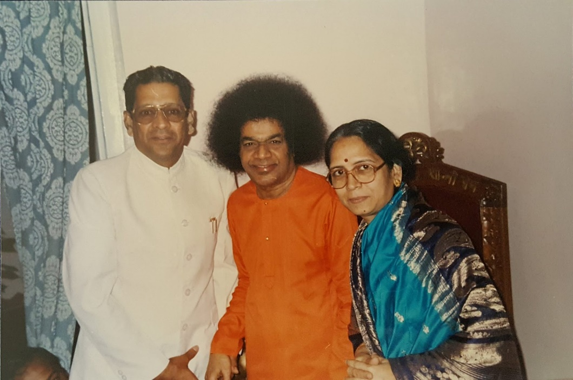
One with Sai
Prof. Anil Kumar Kamaraju &
Mrs.Vijaya Lakshmi Kamaraju
followed by a
Musical Program
Saturday, June 1st 2019
9:30 AM – 3:45 PM
Temple Auditorium,
1232 Arrowhead Ave, Livermore CA 94551
For Registration and details, please visit
http://www.region7saicenters.org/devotion/2019/index.html

Slide 2
Registration, Arrival and Parking
Registration is required by May 25th for planning the event
While registering, sign-up for volunteering
Volunteer/food signups available with your service coordinator
Please be seated by 9:00am
Front rows seating for Senior citizens will be blocked until 9:00am
Volunteers will help with seating inside the auditorium
Doing our best to save the environment - Bring your reusable water bottle, travel mug for coffee/tea and cloth napkins
Boxed lunch is served

Slide 3
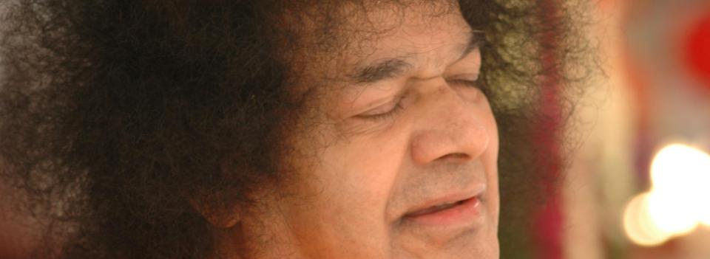
~ Loving Sai Ram ~
Event Co Leads
Devotion ~ Kshitij Shrivatsava
Volunteer and Logistics ~ Ramanj Pamidi and Indranil Dey
Food ~ Ajay Patel ~ Vani Ganapathy
Altar ~ Srinivas Talluri
Regional Contacts ~ Mohan Bhyravbhotla and Murali Krishnaiyer
http://www.region7saicenters.org/devotion/2019/index.html

